Slide 1
Face Attendence System
Project : 09

Slide 2
Project station : MENLOHACKS 2021
Made by:
Prasan Singh
Dakshita

Slide 3
Table of Contents
Introduction
Utility
Tools and Technology
Methodology used
Functionality
Demo
Learning Outcomes

Slide 4
INTRODUCTION
A python based attendance management application that uses facial recognition.
Marks attendance,along with in-time and out-time.
Graphical and tabular representation of attendance data.
Features of registering employees, adding photos etc.
Filter attendance by day or employee.

Slide 5
UTILITY
Traditional Attendance System : -
Time Consuming
Could be manipulated
Hard to visualize
Our System : -
Automated
Takes only a second
Data Visualization incorporated
Cannot be tampered with
Apart from the corporates, it could be used in Schools, Colleges, Housing Society and any other place for security purposes as well.

Slide 6
TOOLS AND TECHNOLOGY USED
Python - Programming language.
OpenCV, TensorFlow/Keras - image processing.
Django - web development
HTML, CSS, Bootstrap - front end development
Matplotlib, glob, Numpy, Pillow - data handling and visualisation

Slide 7
METHODOLOGY

Slide 8
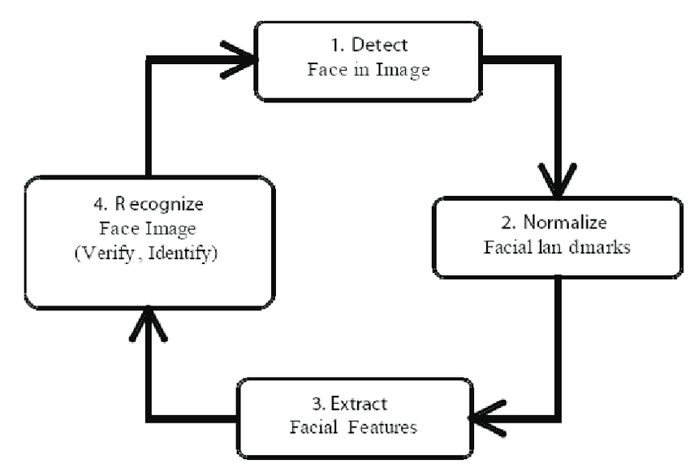
Face Recognition

Slide 9
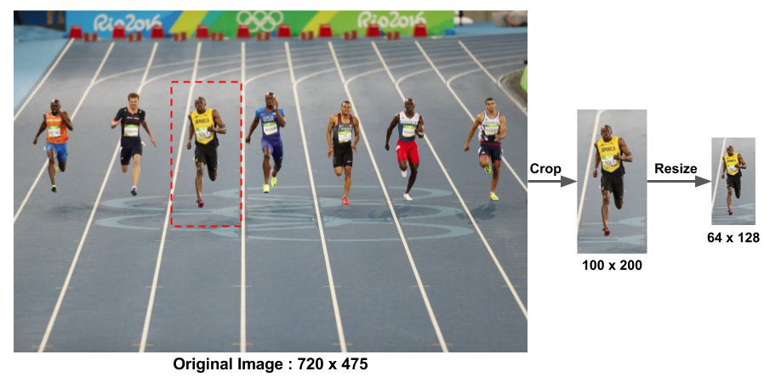
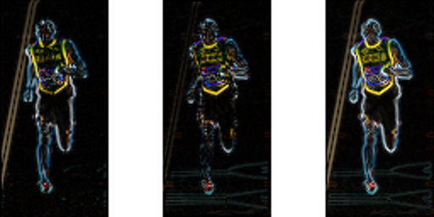
Face Detection - Local Binary Pattern Histogram(LBPH)
HOW IT WORKS
More enhanced model over edge detection.
Resizes the image.
Finds gradient along x and y axis.
Superimpose these gradients to form a complete image.
Extracts the gradient magnitude and gradient direction from the superposition of x and y gradients.
Dividing this images in 8*8 matrix and 9 bins.
Superimposed gradient
Y-gradient
X-gradient

Slide 10
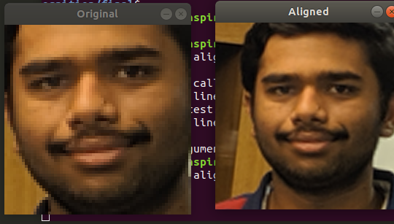
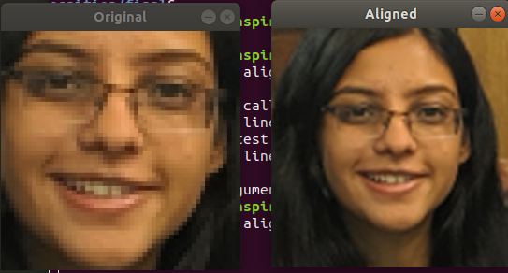
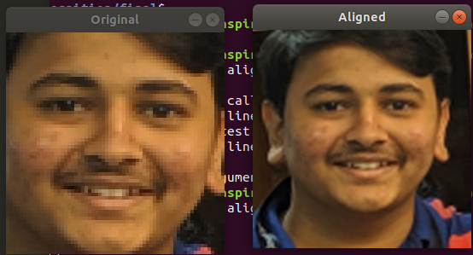
Alignment
Goal : To warp and transform the input image (coordinates) onto an output coordinate space, such that, each face in the output coordinate space be:
Be centered in the image.
Be rotated that such the eyes lie on a horizontal line (i.e., the face is rotated such that the eyes lie along the same y-coordinates).
Be scaled such that the size of the faces are approximately identical.
Facial recognition algorithms perform better on aligned faces.

Slide 11
Web Development
Framework- Django
Bootstrap
HTML
CSS
Python
Database- SQLite3 - Well integrated with Django’s ORM

Slide 12
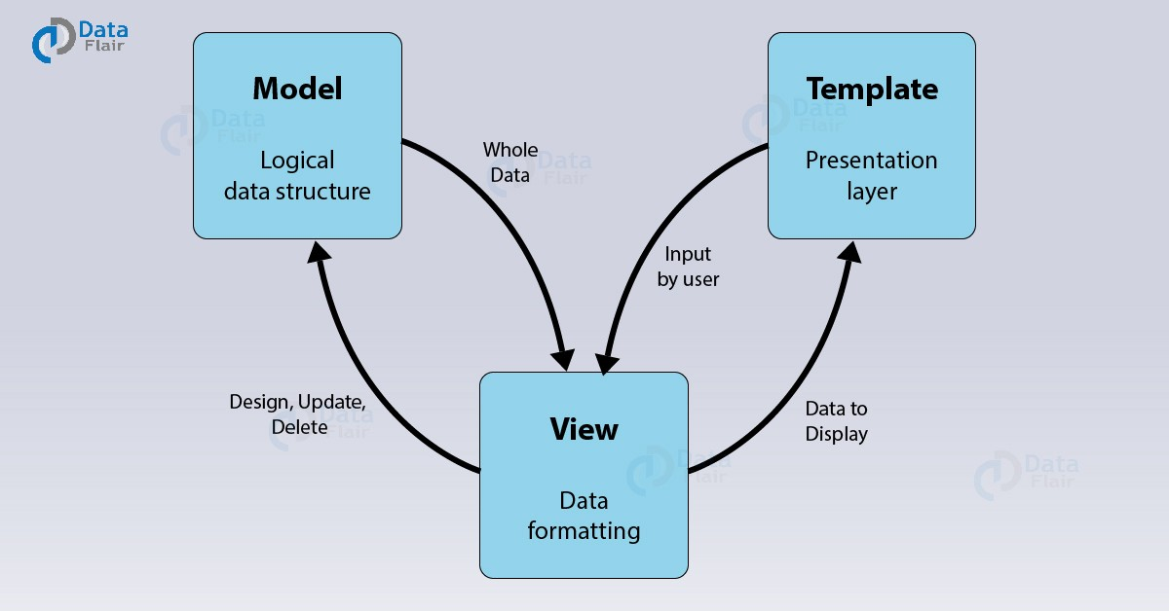
MTV Architecture

